Slide 1

New York Red Bull Soccer Event Analysis
Presentor Zhaoyang Li
New York Red Bull Match Event Analysis
Analyzer: Zhaoyang Li
1 | Zhaoyang Li

Slide 2

Analysis Introduction
Analysis of cross-sectional data
Data Sets
match events for test
Main Programming Skill
Python
Purpose of Analysis
Part 1: Analyzing correlation with each variables that influence on NYRB’s match.
Part 2: Analyzing the game content through on-field data.
‹#› | Zhaoyang Li

Slide 3

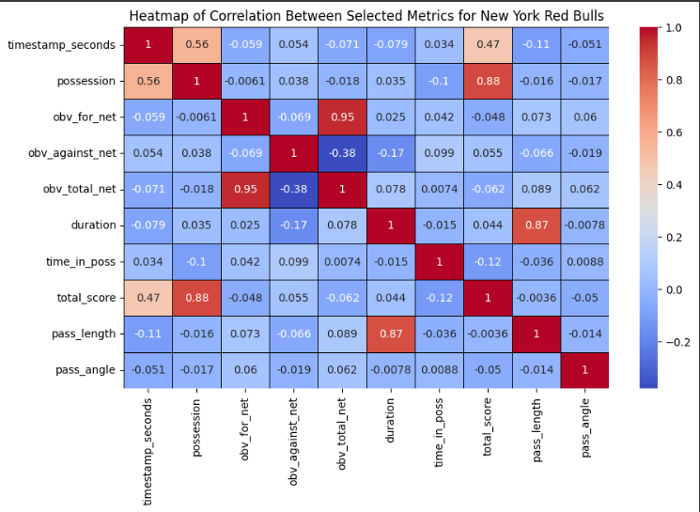
NYRB Correlation Heatmap Analysis
Key Positive Correlations
Possession vs. Total Score (0.88): This strong correlation indicates that for the NYRB, higher possession is significantly associated with a higher total score in the OBV model. This underscores the effectiveness of possession in generating valuable plays, possibly due to more opportunities to attack and control the game.
Duration vs. Time in Possession (0.87): The longer the duration of plays, the more the team is maintaining possession. This reflects a controlled playing style where extended play sequences often involve retaining possession, potentially to set up structured attacks.
Total Score vs. Duration (0.44): A moderate correlation indicates that not only is possession time important, but also the duration of individual plays. Longer possession durations are somewhat associated with higher scoring, possibly through sustained attacks that create more scoring opportunities.
Presentor Zhaoyang Li
Key Negative Correlations
OBV_for_net vs. OBV_against_net (-0.95): This strong negative correlation indicates a significant inverse relationship between positive actions towards scoring and the value lost to opponents. When NYRB is effectively creating positive OBV, it directly reduces the opponent's opportunities to create their own positive OBV. This could mean that NYRB’s effective playmaking and defensive strategies minimize the impact of opponent actions.
Pass Length vs. OBV_for_net (-0.11) and Pass Length vs. Total Score (-0.11): While these correlations are relatively weak, they hint that longer passes are slightly negatively correlated with both on-ball value and scores. This could suggest that shorter, more controlled passes might be more effective for maintaining possession and creating scoring chances than longer, riskier passes.
Neutral Correlations
Time in Possession vs. Total Score (-0.036):The near-zero correlation here suggests that simply holding the ball (time in possession) does not directly correlate with scoring. This highlights that the quality or effectiveness of how possession time is utilized is more crucial than the mere amount of time held.
‹#› | Zhaoyang Li

Slide 4
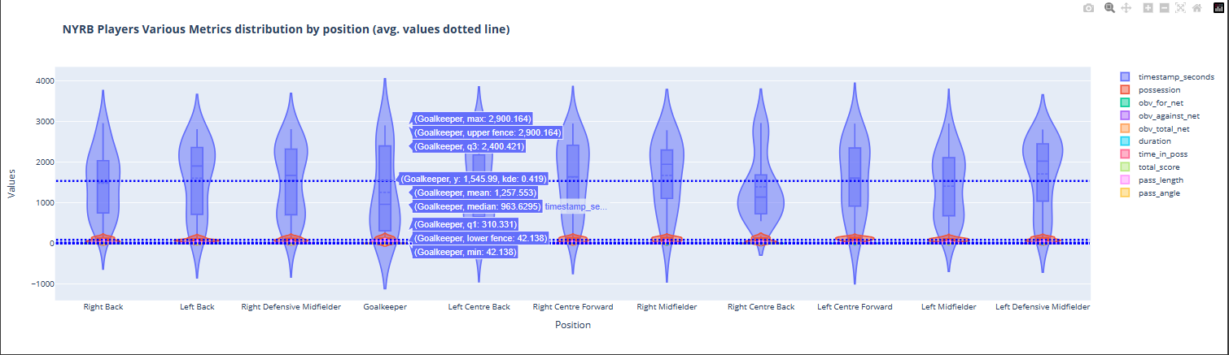
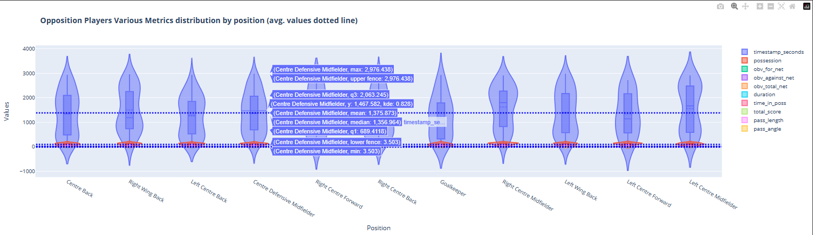
Presentor Zhaoyang Li
NYRB & Opposition Violin plot visualization
Violin Plots Introductio：These violin plots provide valuable insights into the range and distribution of performance metrics across different player positions for NYRB and their opposition. Better understand performance consistencies and variabilities, which can guide strategic decisions, training focuses, and game tactics.
Comparative Analysis: Comparing the two plots, it’s evident that both teams exhibit similar patterns in variability and distribution across comparable positions. However, specific roles like the central defensive midfielder for the opposition and the goalkeepers for both teams highlight different tactical emphases or individual performances.
‹#› | Zhaoyang Li

Slide 5
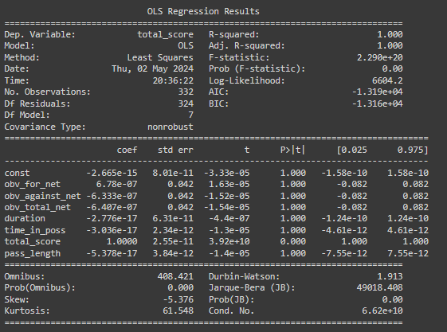
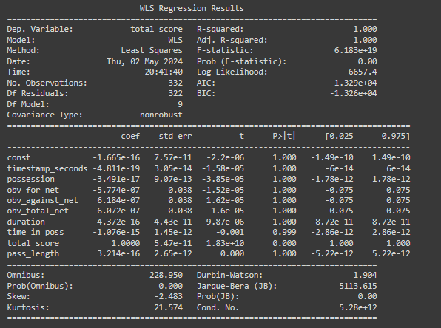
NYRB OLS & WLS Regression Analysis
Presentor Zhaoyang Li
Comparative Analysis of OLS vs. WLS: WLS accounts for heteroscedasticity — unequal scatter of data points across the regression line. This approach can be particularly useful in carry different weights or have different variances associated with them compared to regular matches.
‘obv_for_net’ and ‘time_in_poss’: ‘obv_for_net’ and ‘time_in_poss’: These coefficients are significant and show a strong relationship with the total score. A positive coefficient means higher On-Ball Value is associated with more goals scored. Similarly, time_in_poss(1.36e-10 in OLS) being positively correlated with scoring suggests that maintaining possession correlates with scoring opportunities and possibly goals.
Model Fit and Diagnostics: Perfect Fit (R-squared = 1.000).
Durbin-Watson Statistic: The values close to 2 suggest that there's minimal autocorrelation in the residuals, which is good.
Jarque-Bera Test: The high values indicate that the residuals are not normally distributed, which could affect the reliability of the model’s standard errors and confidence intervals. In predicting this soccer match outcomes, this might limit the model’s applicability in different scenarios or across different teams.
‹#› | Zhaoyang Li

Slide 6
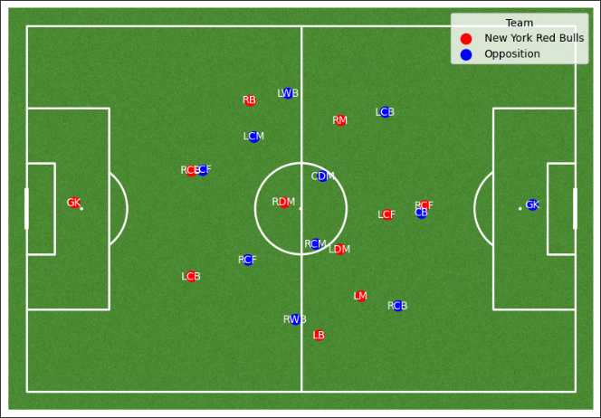
Presentor Zhaoyang Li
Brief overview of the tactical formations
Team Formations
New York Red Bulls: 4-4-2, emphasizing the role distribution from defense to attack.
The position of the LCF here is relatively deeper, similar to an AMF role. In this match, the RCF mostly takes on the responsibilities of a lone striker.
Opposition: 5-2-2-1, defensive-oriented structure that emphasizes stability and flexibility.
the LWB and RWB positions are relatively forward, essentially positioned in the midfield area. Positioned similarly to the LMF and RMF.
‹#› | Zhaoyang Li

Slide 7
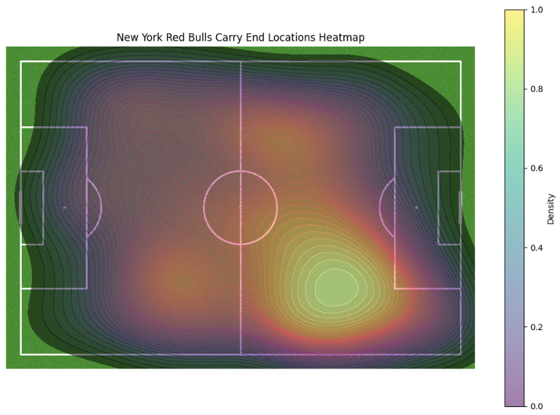
Presentor Zhaoyang Li
Key Observations:
Central Concentration: Strong concentration of carry ends around the central area of the pitch, extending from the defensive half into the middle third. This suggests that the team frequently progresses the ball to this area, likely transitioning from defense to attack.
High Activity in Midfield: The high-density zones near the center circle indicate that a significant portion of play happens in midfield. This could be due to the midfielders being heavily involved in ball distribution and carrying the ball through the central channel.
Less Activity on Flanks: The lower density on the sidelines suggests that carries end less frequently in these areas compared to the central part of the field. This might indicate a playing style that favors minimizing risk by not losing possession on the sidelines.
Forward Third Activity: There's a noticeable increase in density around the top of the penalty box and slightly into the final third, though it's less than in the midfield. This region of increased activity could reflect attempts to set up shots on goal or final key passes.
NYRB Carry Analysis
‹#› | Zhaoyang Li

Slide 8
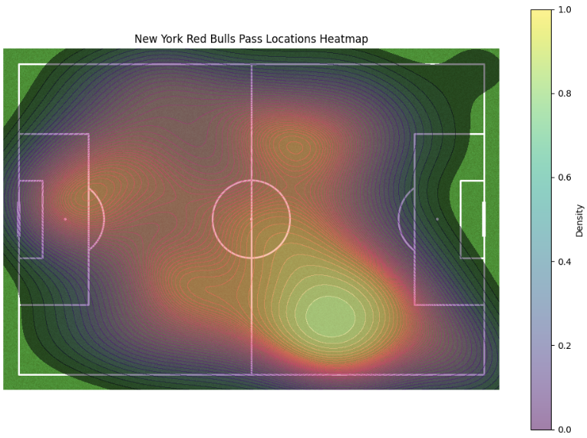
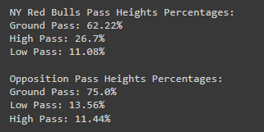
NYRB Pass Analysis
Presentor Zhaoyang Li
Key Observations:
Central Focus: A significant concentration of pass activities in the central area of the field, both in the defensive half near the center circle and advancing towards the midfield. This indicates that the team heavily utilizes central routes for building up plays.
Activity in Final Third: There is notable activity around the edge of the opposition’s penalty area, suggesting attempts to penetrate the defense through passes aimed at creating scoring opportunities.
Limited Flank Usage: Similar to the carry end locations, the flanks show lesser activity compared to central areas, which might suggest a tactical preference for central attacks or a possible area for tactical expansion to diversify attacking routes.
Ground Passes: 62.22%, which is the majority of their passes, indicating a play style that relies on keeping the ball on the ground, potentially to maintain possession and control the pace of the game.
High Passes: 26.7%, showing a significant use of aerial balls, which might be aimed at bypassing midfield congestion or targeting forwards directly.
Low Passes: 11.08%, used less frequently, these could be tactical passes like low crosses or driven balls that are not completely aerial.
‹#› | Zhaoyang Li

Slide 9
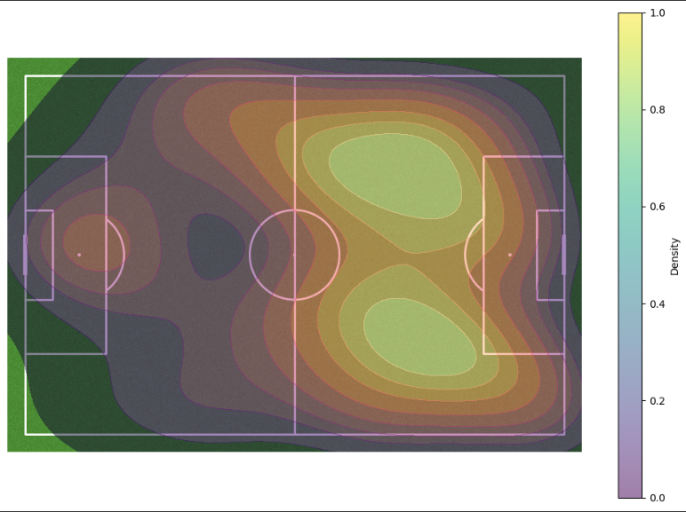
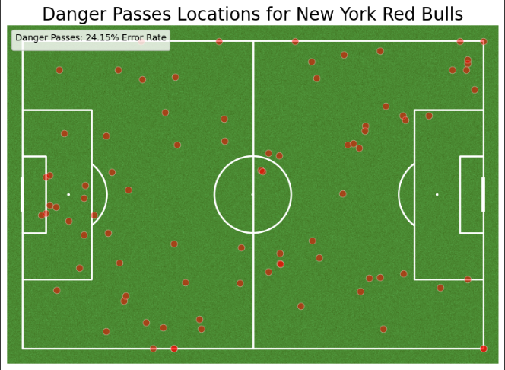
NYRB Danger Pass Analysis
Presentor Zhaoyang Li
Danger Pass Density Heatmap:
High-Risk Areas::Highlighting areas of the field where danger passes are most frequently attempted.
The highest densities are observed near the halfway line and just outside the opposition's penalty area. This likely reflects attempts to transition quickly into attacking positions or to create scoring opportunities through penetrating passes.
Tactical Implications: The concentration of danger passes in the central lanes suggests a tactical approach centered around penetrating through the middle, possibly due to player positioning and the roles of central midfielders and forwards.
Danger Pass Locations：
High-Risk Areas:The left image plots individual instances of danger passes across the field, marked by red dots. These locations provide a precise view of where risky or unsuccessful passes tend to occur.
Error Rate: 24.15% error rate suggests that nearly a quarter of these intended danger passes result in turnovers or are not completed successfully, posing potential risks of counter-attacks.
‹#› | Zhaoyang Li

Slide 10
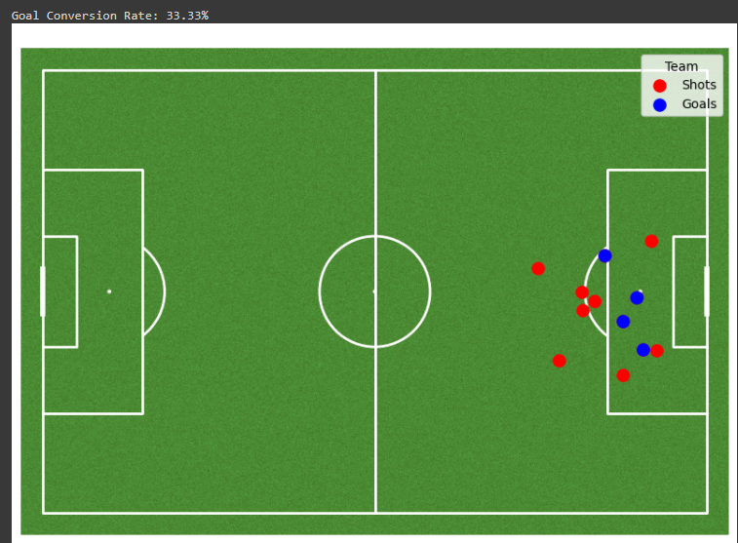
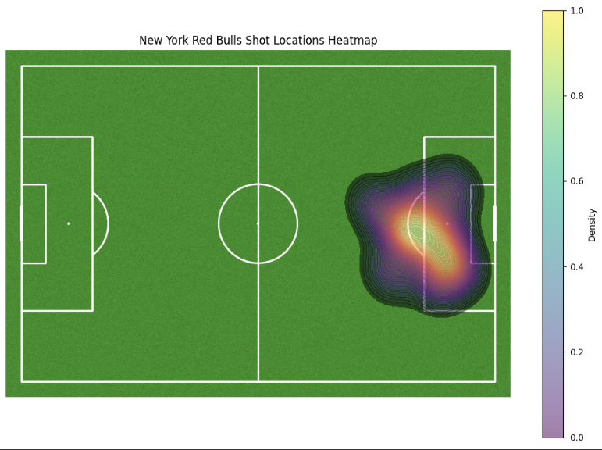
NYRB Shot Analysis
Presentor Zhaoyang Li
Shot Distribution Key Observations:
Concentration Area: The red dots represent the location of each shot taken by NYRB. Observing the spread, while many shots are clustered around the penalty area, there are also several taken from further back, indicating a willingness to attempt long-range shots.
Goal Conversion Rate: The noted goal conversion rate is 33.33%, which is fairly high.
Heatmap Key Observations:
Concentration Area: Concentration of shots taken from a central position just outside the penalty box.
Intensity and Spread: The color intensity suggests that most shots are concentrated in this central area, but there is a broader, lighter spread that indicates attempts from wider and farther distances. This spread could suggest attempts from less optimal positions or a diverse attacking strategy that doesn't solely rely on central plays.
‹#› | Zhaoyang Li

Slide 11
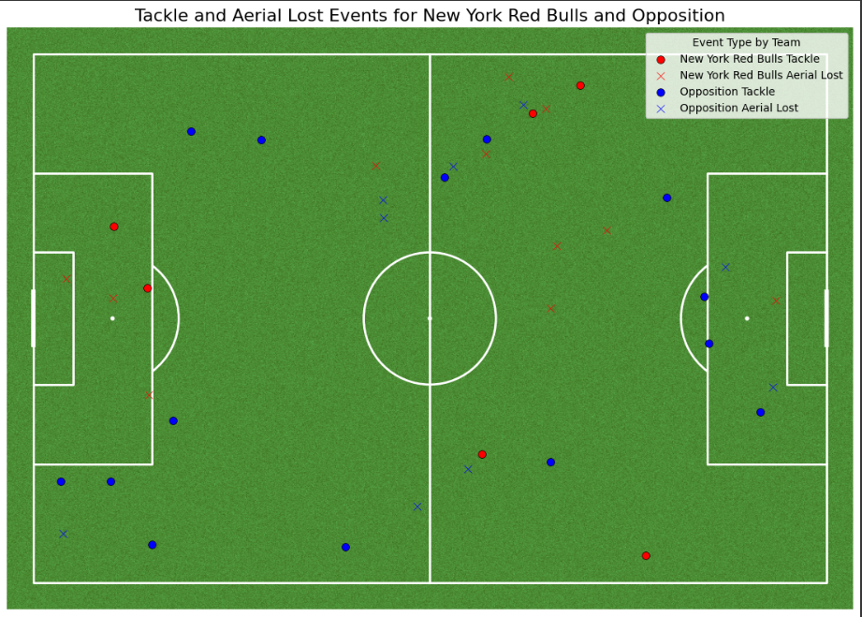
NYRB & Opposition Tackles & Aerial Duels Analysis
Presentor Zhaoyang Li
Tackles Key Observations:
Distribution and Frequency:The red dots indicating tackles by NYRB are distributed primarily in their own half and near the midfield, suggesting defensive efforts to regain possession in these areas.
Blue dots are more scattered across the field, including a significant presence in the NYRB half, which implies that the opposition actively attempts to disrupt play and gain possession in advanced positions.
Aerial Duel Outcomes:
Red Xs show where NYRB players have lost aerial duels. These are fairly evenly spread across the field but with a slight concentration in the defensive half, indicating areas where NYRB might be vulnerable in air battles.
Blue Xs, representing aerial duels lost by the opposition, are also spread across the field, with a noticeable presence in the NYRB half. This suggests that while NYRB does lose some aerial contests, they are also effective at forcing errors in aerial duels by the opposition.
‹#› | Zhaoyang Li

Slide 12
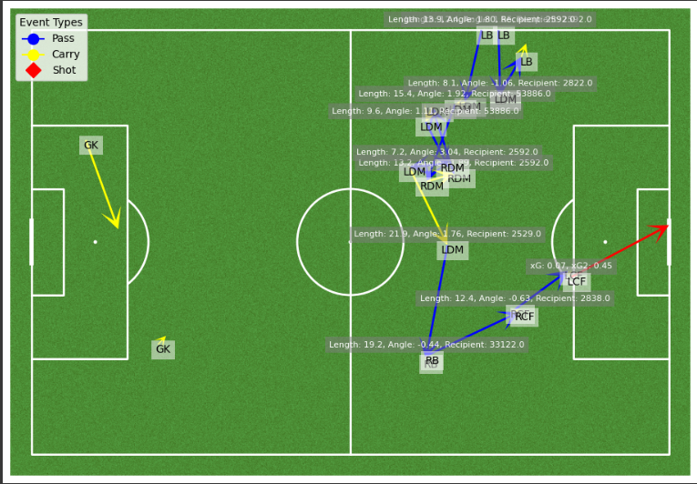
NYRB First Goal-Scoring Analysis
Presentor Zhaoyang Li
Build-Up Play:
Starting throw in from the Left side: The action begins in NYRB’s offensive half with the LB (indicated by the blue arrows representing pass in image).
Progression to Midfield: The flow of play moves from right to left, involving a strategic shift of the ball across the pitch. Such lateral movements are effective in stretching the opposing defense and creating gaps that can be exploited. The ball is then played to the RB, who appears to carry it forward before making a pass. This progresses through the RCF and culminates in a successful shot by the LCF.
Final Execution: The progresses through the RCF and pass to LCF, with a short dribble to position themselves optimally. The LCF then executes a shot from the right side.
‹#› | Zhaoyang Li

Slide 13
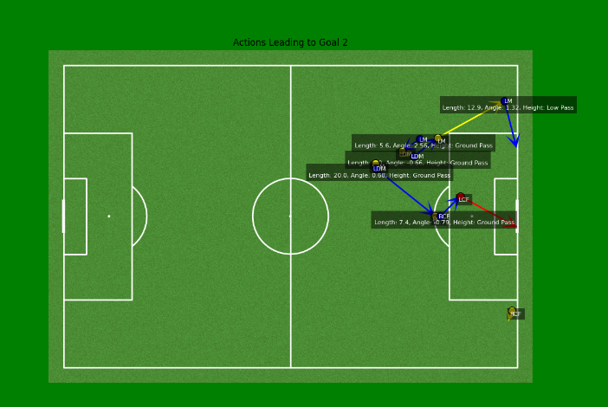
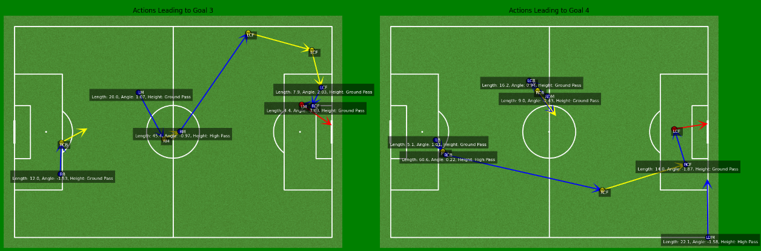
Presentor Zhaoyang Li
Analysis Comparing Remaining Goals
with the First Goal for NYRB
Key Observations:
Second Goal:The second goal exemplified a classic play initiated from the midfield. The sequence involved dribbling through the central channel, followed by a pass to the LDM. The LDM then passed the ball to the RCF, who finally relayed it to the LCF. The LCF executed a direct shot inside the penalty area, resulting in a goal.
Third and Fourth Goals:Unlike the first two goals, the third and fourth goals were distinct in their approach. Both goals originated from the defensive half with long high passes to the flanks. Subsequently, both the LCF and RCF used dribbling skills to
advance the ball into the penalty area. They utilized ground passes to relay the ball to another approaching forward, creating excellent shooting opportunities that led to the third and fourth goals.
‹#› | Zhaoyang Li

Slide 14
Conclusion
Presentor Zhaoyang Li
Strategic Insights from Statistical Analysis:
Correlation Analysis: Demonstrated strong relationships between possession, duration, and scoring in the OBV model, highlighting the tactical necessity of effective ball control and usage duration for enhancing game outcomes.
Regression Models: Identified OBV_for_net and possession as key predictors of success. However, careful attention is needed to avoid overfitting while incorporating these metrics into strategic planning.
Visual Data Revelations:
Heatmaps and Density Plots: Revealed critical areas of play, particularly the central zones of the pitch, which are crucial for building attacks and maintaining possession. The strong correlation between possession and OBV metrics emphasizes the importance of these areas.
Tactical Formations: Analysis of different formations underscored NYRB's flexibility and strategic alignment, adapting their tactics to maximize strengths and mitigate weaknesses. The data supports continued use of formations that enhance possession and on-ball value.
Visual Tactical Performance & Adjustments:
Effective Utilization of Central & Flanks Plays: The analysis highlighted NYRB's focus on central routes and using long high passes to the flanks to create scoring opportunities. Consideration of the negative correlation between pass length and OBV suggests reevaluating the risk and reward of long passes.
Danger Pass Analysis: Identified high-risk areas, particularly in transitioning into attacking positions. The notable negative correlation between pass length and OBV_for_net suggests that shorter, more controlled passes may reduce turnovers and counter-attack risks.
Recommendations for Future Matches:
Continued Analytical Assessments: Regular updating of analytical models to incorporate the latest match data and opponent analysis, ensuring strategies remain responsive to dynamic competitive conditions.
Enhanced Tactical Adjustments: Encourage exploration of flank plays to exploit wider areas of the pitch, potentially opening up new attacking avenues. However, integrate findings about pass length and OBV to ensure that these plays optimize value without increasing risk.
Long-term Strategic Implications:
Data-Driven Decision Making: Foster a culture of continuous improvement through data-driven insights, ensuring that tactical decisions are always aligned with empirical evidence.
Player Development and Training: Tailor training programs to enhance player skills in key identified areas such as pass accuracy in high-risk situations. Focus on improving decision-making for when and where to pass, particularly in maintaining possession and creating value in high-pressure situations.
‹#› | Zhaoyang Li

